Slide 1

Credit Card Fraud Detection using Python
Chandrika Bondhu
11/27/2013

Slide 2

Content
Introduction
Problem Definition
Advantages
Types of Credit card fraud
Technologies and tools used
Use case Diagram
Activity Diagram
Data and packages import
Graphs and matric
Conclusion
References

Slide 3

Introduction
A vital component of protecting people and companies against financial losses and fraudulent activity is the identification of fraud in financial transactions.
The need for reliable and efficient fraud detection systems is growing as financial transactions become more digital and as criminals' methods evolve. Because machine learning algorithms like Random Forest and K-means can perform categorization jobs and deliver meaningful data, they have become essential tools in this industry. Data mining techniques are used in the study's examination of this data to identify significant trends and insights pertaining to fraudulent conduct. Training and optimizing the fraud detection model involves the use of supervised learning methods such as logistic regression, random forests, and gradient boosting.

Slide 4
Problem Definition
The challenge in detecting credit card fraud using Python is to create a robust system that uses Python's programming capabilities to quickly and precisely identify unauthorized transactions. This entails developing algorithms and models for analyzing transaction data, implementing real-time monitoring for quick detection, and adapting to emerging fraud techniques. Python's machine learning and data analytics packages are critical for analyzing huge datasets efficiently. Minimizing false positives, using behavioral analytics, and maintaining regulatory compliance are all critical goals. To effectively battle the evolving landscape of credit card fraud, the solution should provide a multi-layered security approach, including user education.

Slide 5
Advantages
Improved customer relationships
Increased authorization rates
Reduced reserve account requirements
Increased processing volume limits
Improved customer satisfaction

Slide 6
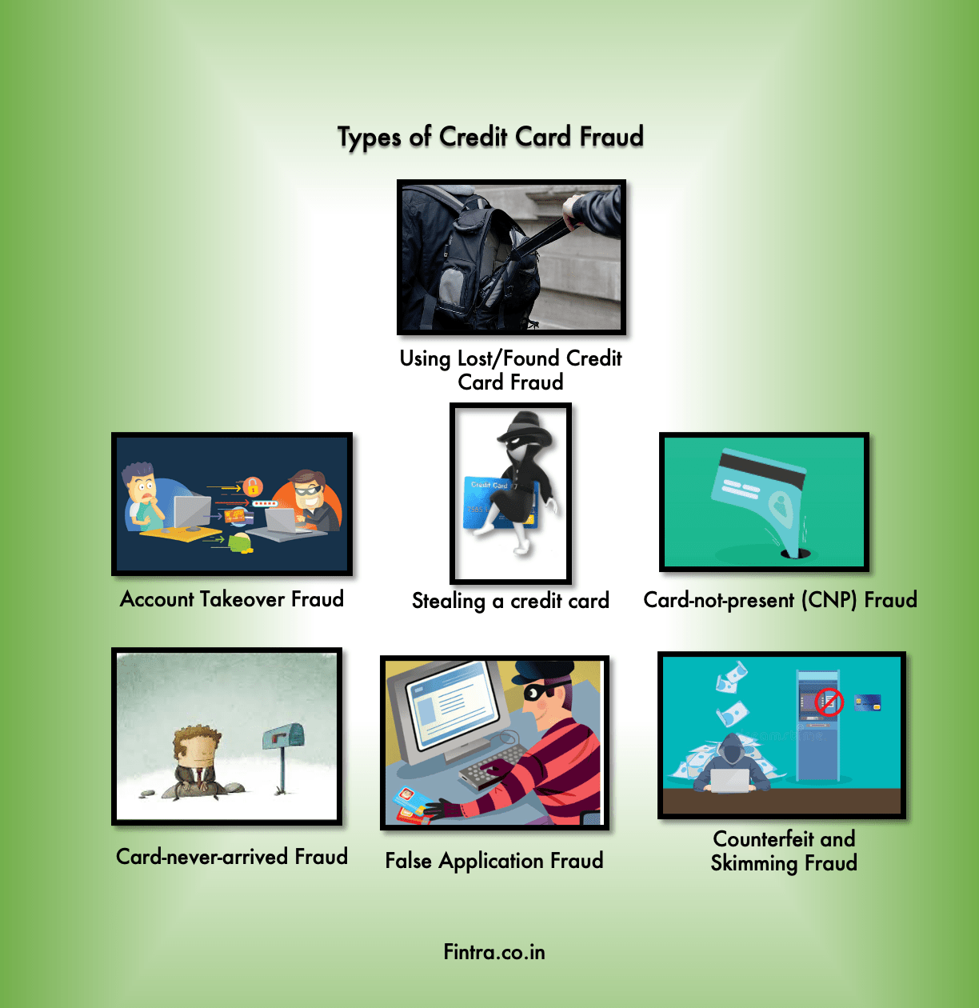

Slide 7
Technology and tools used
Programming Language: Python
Libraries and framework: NumPy, pandas, seaborn, Matplotlib.
Database: csv

Slide 8
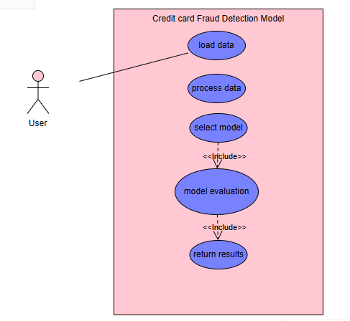
Use-case Diagram

Slide 9
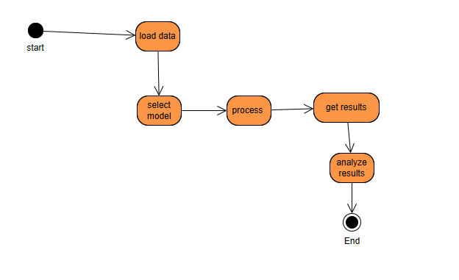
Activity Diagram

Slide 10
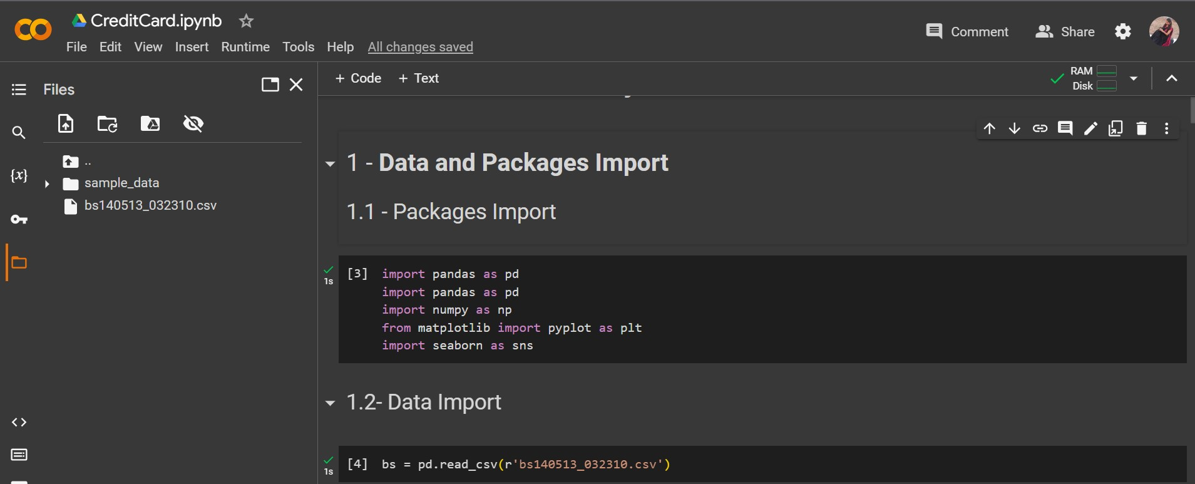
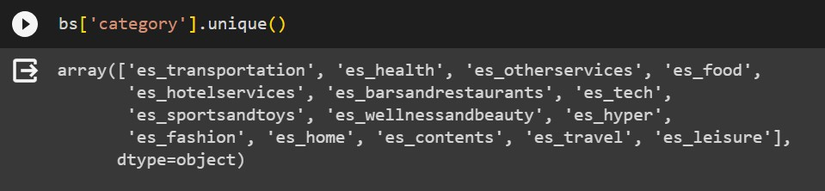

Slide 11
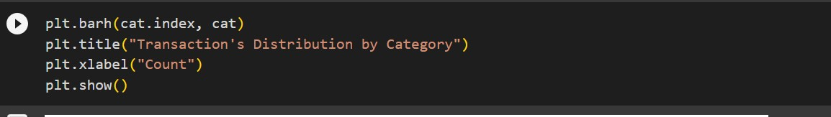
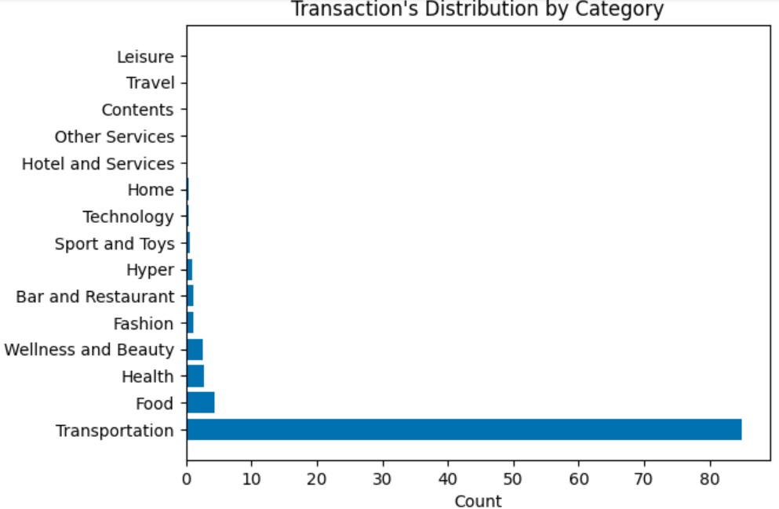

Slide 12
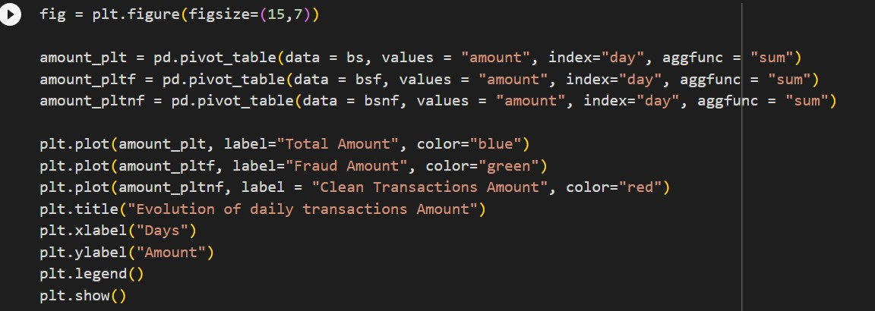
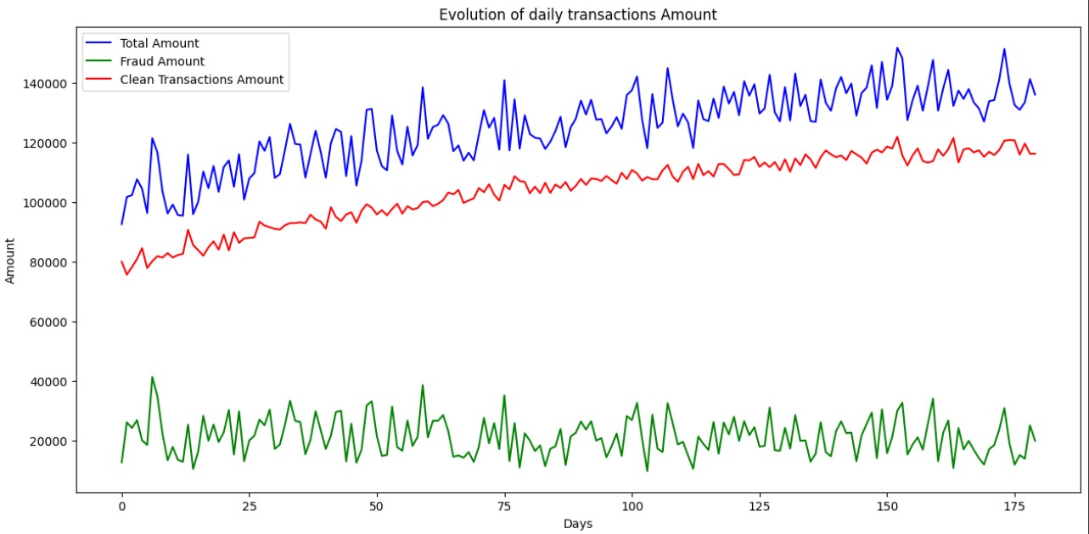

Slide 13
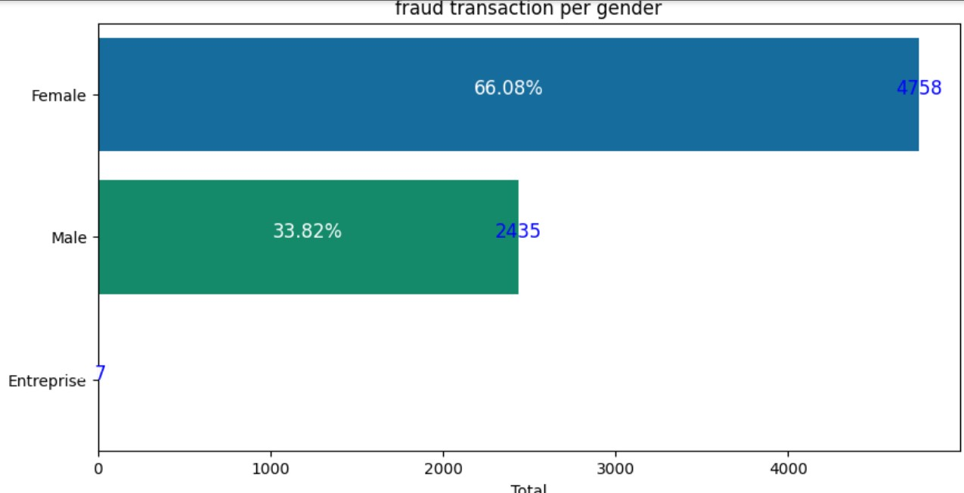
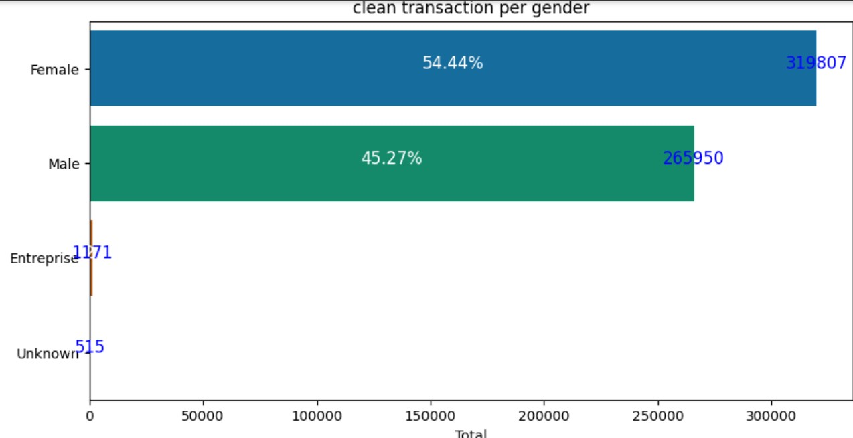

Slide 14
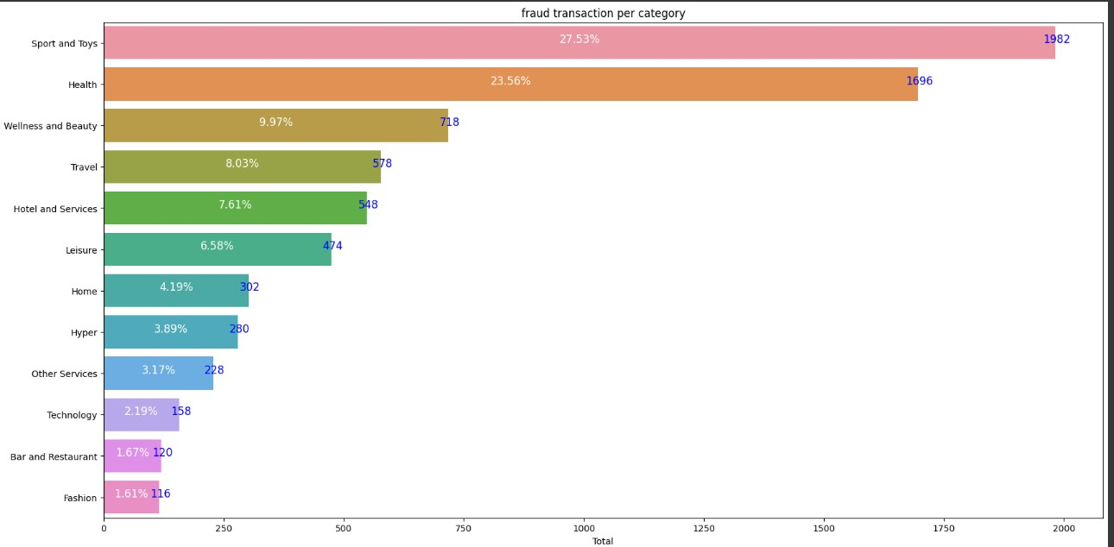

Slide 15
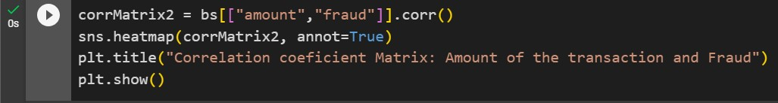
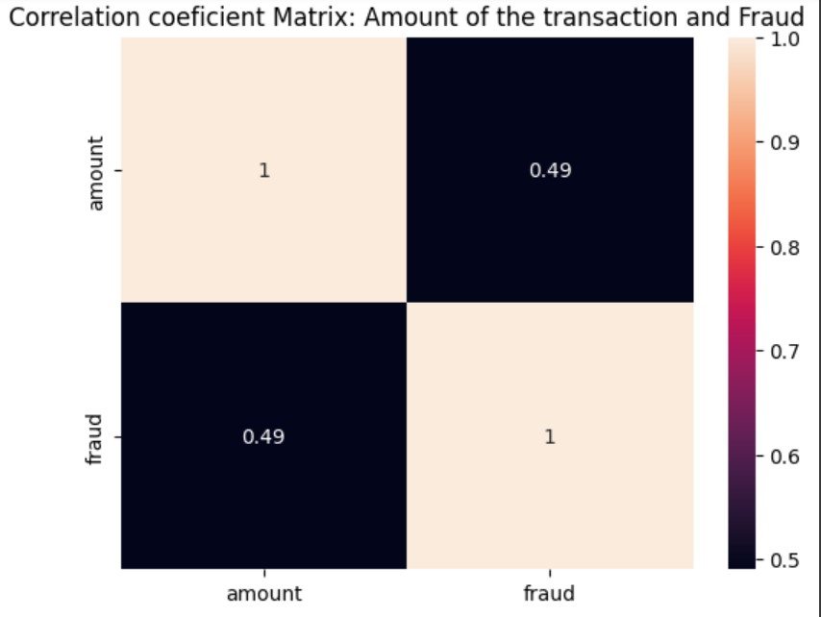

Slide 16
Conclusion
The credit card fraud detection system developed in this project stands as a testament to the efficacy of machine learning algorithms in bolstering security measures against fraudulent transactions. Leveraging the power of advanced algorithms, this system is adept at providing real-time monitoring, anomaly detection, and predictive modeling capabilities, thereby mitigating financial losses resulting from credit card fraud. Real-time monitoring is a critical aspect of fraud prevention, and the system excels in this domain by continuously analyzing transactions as they occur. Machine learning algorithms swiftly assess patterns, scrutinize behaviors, and compare transactions against historical data to identify anomalies in real-time.

Slide 17
References
Correa Bahnsen, A. et al. (2016) ‘Feature engineering strategies for credit card fraud detection’, Expert Systems with Applications, 51, pp. 134–142. doi: 10.1016/j.eswa.2015.12.030
Bui, K. (2016) 4 Reasons Why Fraud Prevention Needs to Move Beyond Rules Based Engines, Feedzai. Available at: https://feedzai.com/blog/4-reasons-why-fraud-prevention-needs-to-move-beyond-rules-based-engines/ (Accessed: 3 November 2018).

Slide 18

Thank you

